Slide 1
Summarizing Data
Statistical Data Analysis, 2023

Slide 2
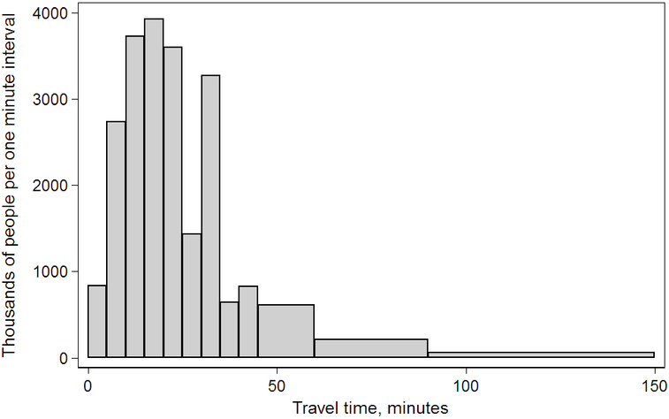
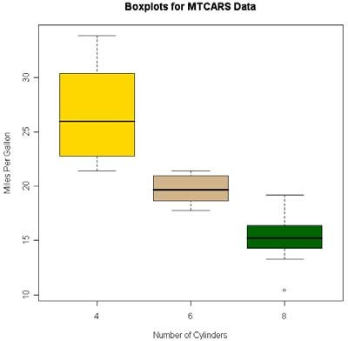
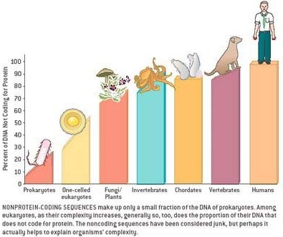
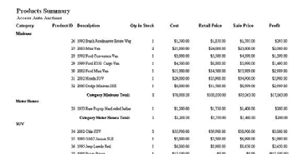
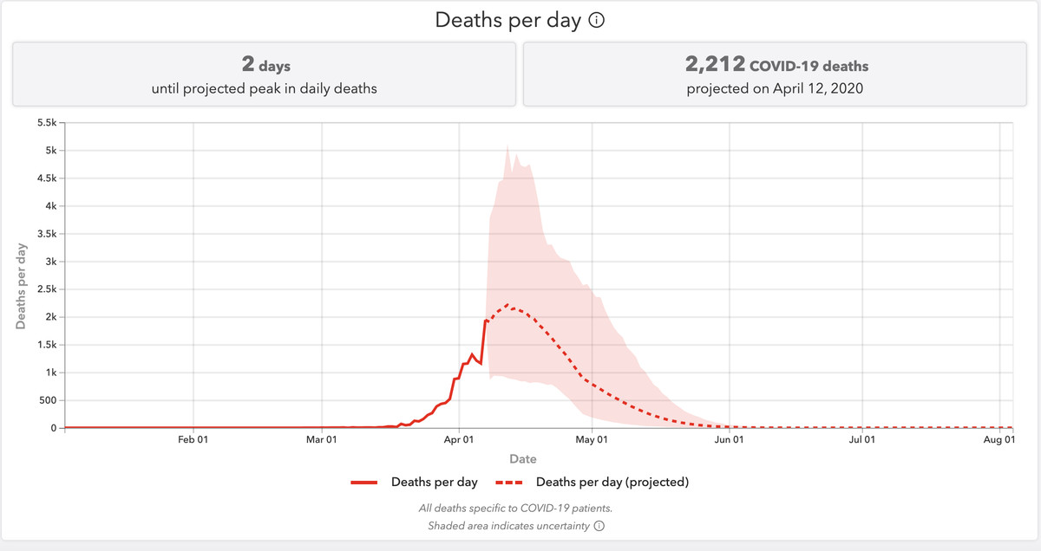
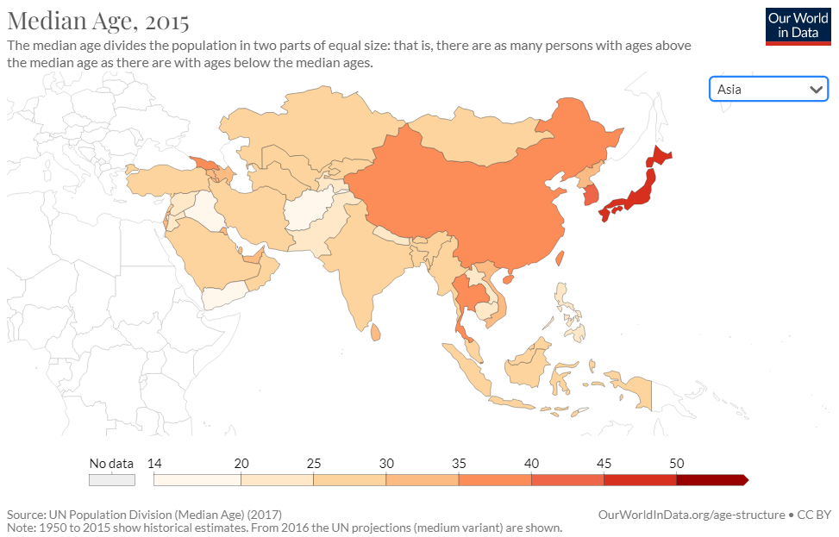
—— Let the data speak for themselves!
——A picture says more than a thousand words!

Slide 3
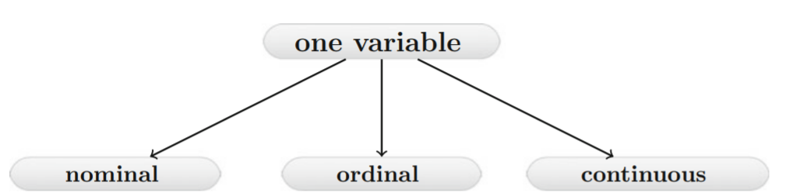
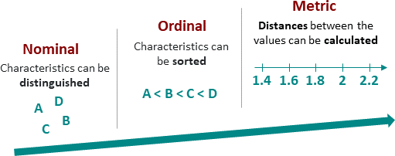
Types of Data

Slide 4
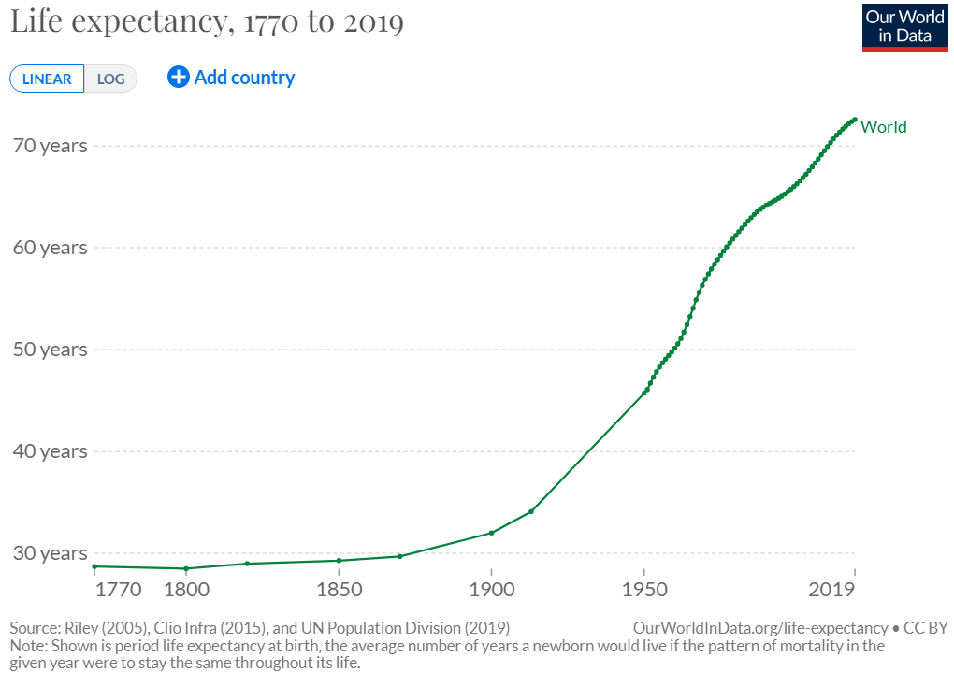
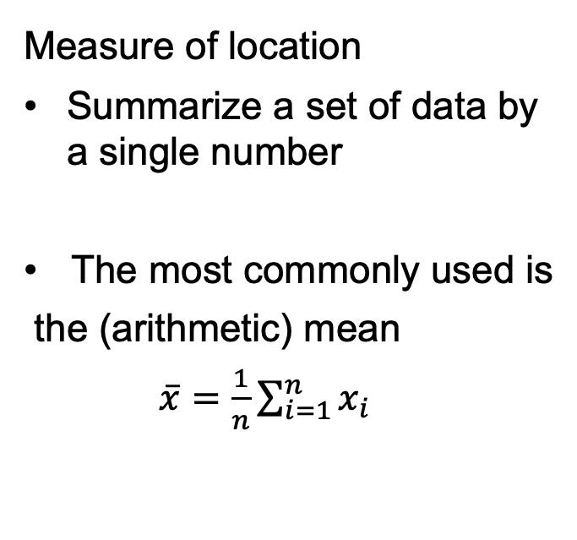
Summary Statistics of Continuous Variables
Measure of location
Summarize a set of data by a single number
The most commonly used is
the (arithmetic) mean
$\overline{x}=\frac{1}{n}\sum_{i=1}^{n}{x_{i}}$

Slide 5
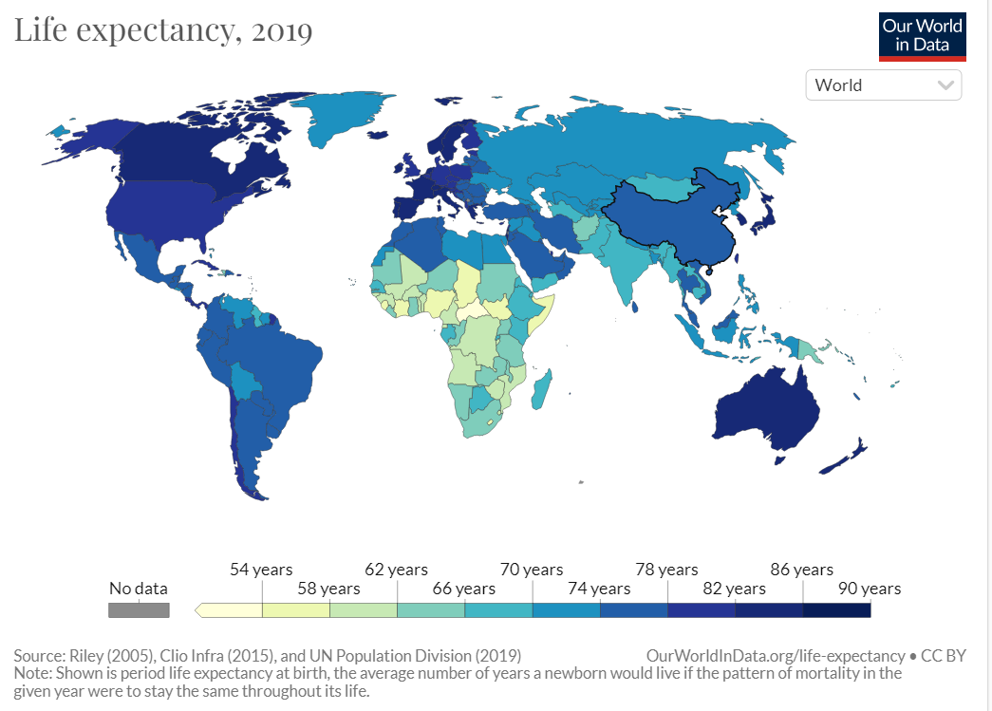

Slide 6
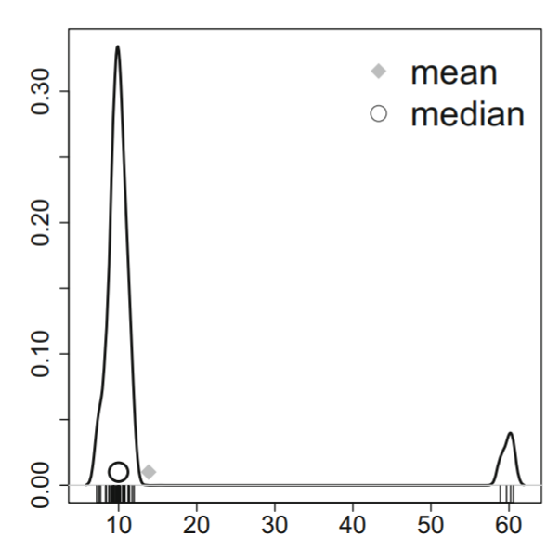
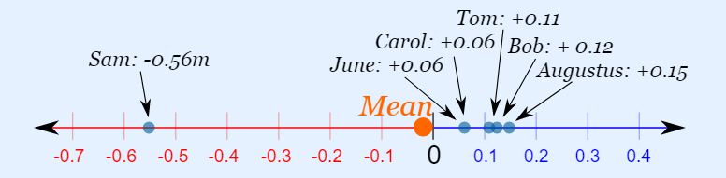
Mean is sensitive to outliers.
More robust estimators?

Slide 7
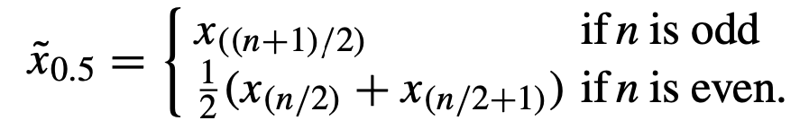
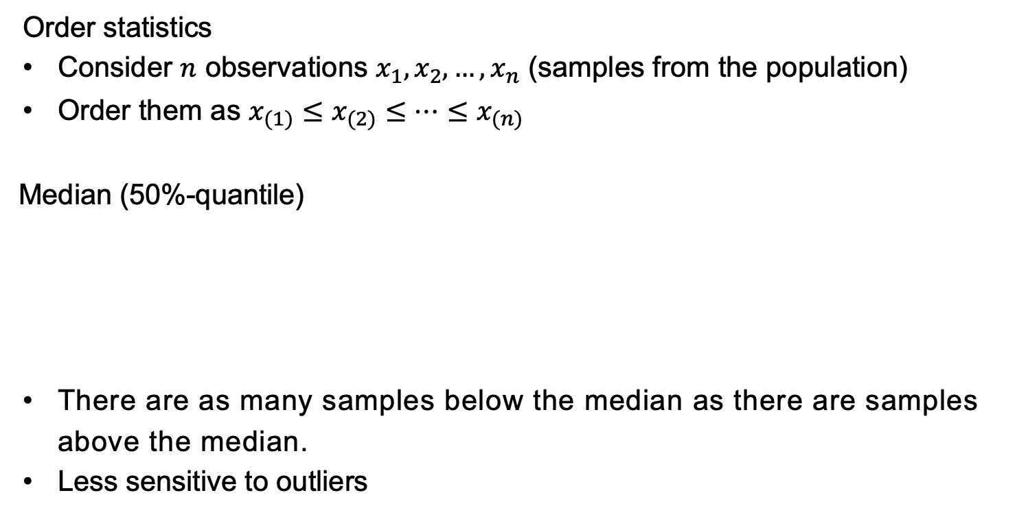
Median
Order statistics
Consider $n$ observations $x_{1},x_{2},…,x_{n}$ (samples from the population)
Order them as $x_{(1)}≤x_{(2)}≤⋯≤x_{(n)}$
Median (50%-quantile)
There are as many samples below the median as there are samples above the median.
Less sensitive to outliers

Slide 8
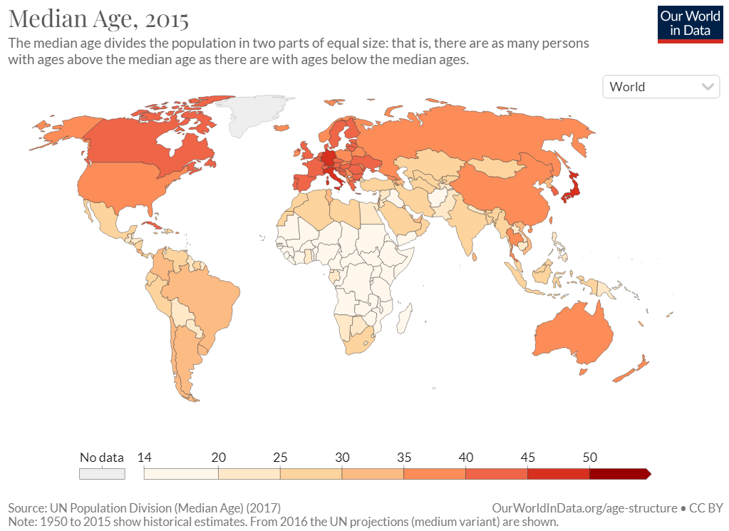
Median age:
Half of the population is below that age and half is above that age

Slide 9
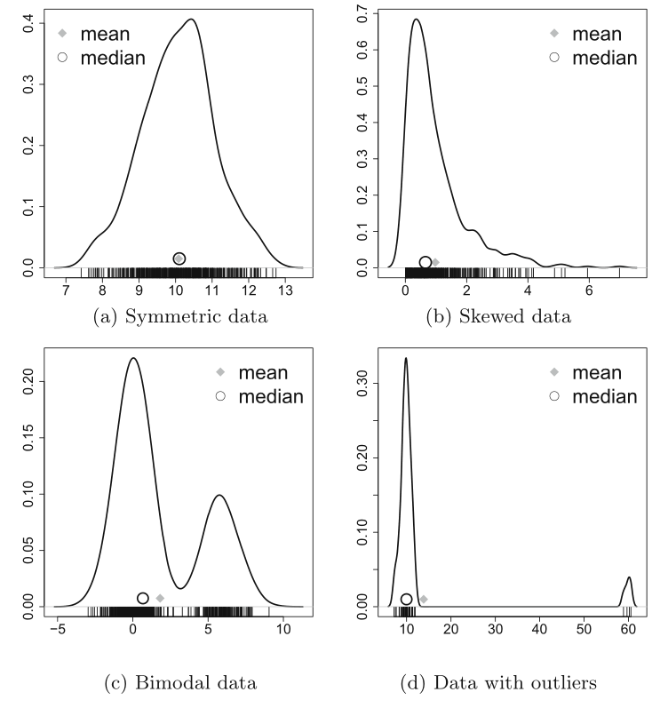
mean vs median in some cases
Notes:
(b) right-skewed data, the right tail brings up the mean.

Slide 10
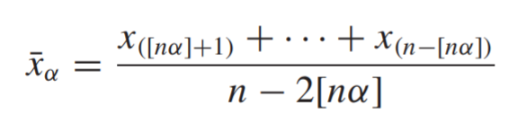

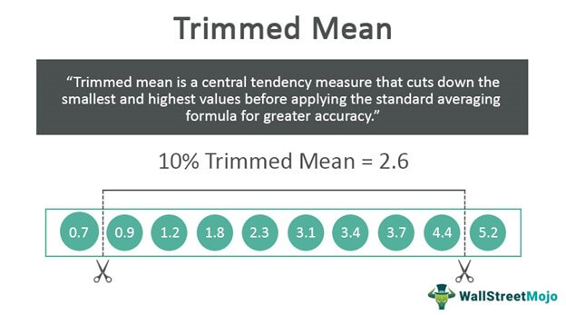
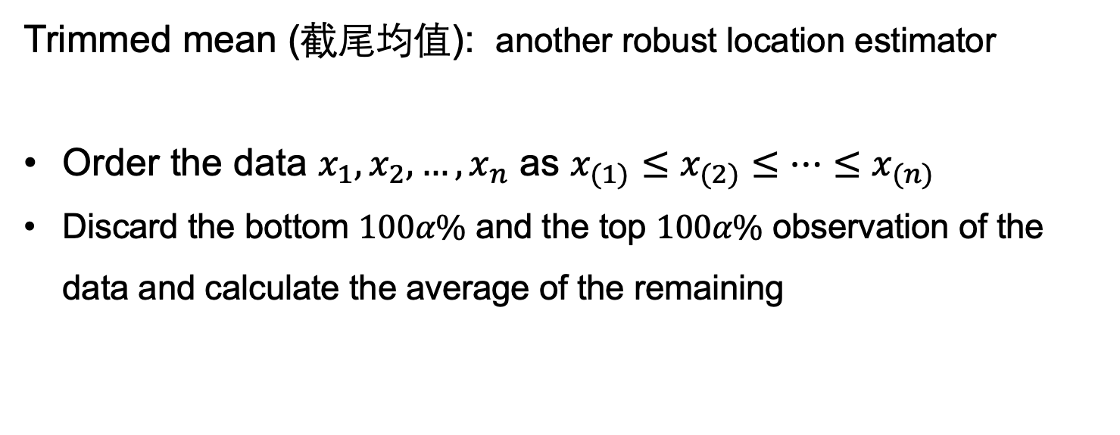
Trimmed mean (截尾均值): another robust location estimator
Order the data $x_{1},x_{2},…,x_{n}$ as $x_{(1)}≤x_{(2)}≤⋯≤x_{(n)}$
Discard the bottom $100α\%$ and the top $100α\%$ observation of the data and calculate the average of the remaining

Slide 11

单选题
1分
In order to robustly estimate the income level of a region,
which of the following estimates should be used?
A
Average income
B
Median income
C
Lowest income
提交

Slide 12
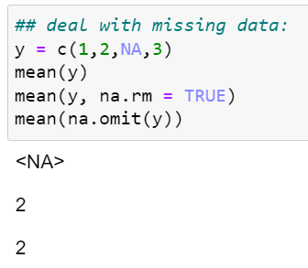
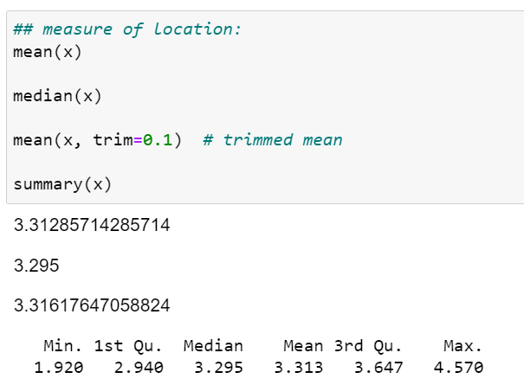
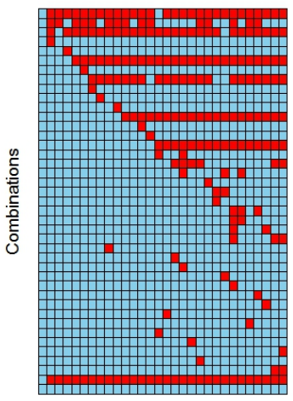
R Code
To deal with missing data

Slide 13
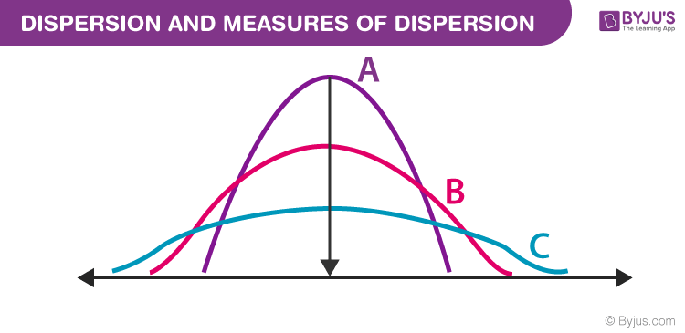
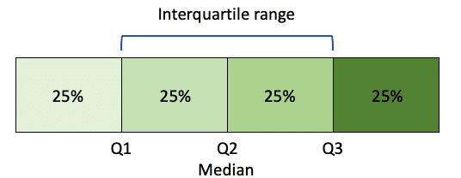
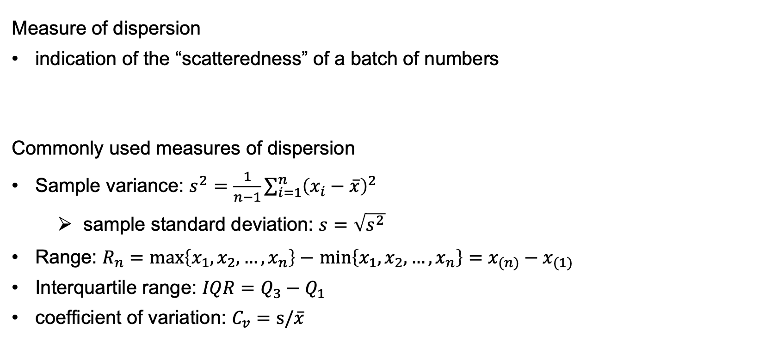
Summary Statistics of Continuous Variables
Measure of dispersion
indication of the “scatteredness” of a batch of numbers
Commonly used measures of dispersion
Sample variance: $s^{2}=\frac{1}{n−1}\sum_{i=1}^{n}{{\left(x_{i}−\overline{x}\right)}^{2}}$
sample standard deviation: $s=\sqrt{s^{2}}$
Range: $R_{n}=max\left\{x_{1},x_{2},…,x_{n}\right\}−$ $min\left\{x_{1},x_{2},…,x_{n}\right\}=x_{(n)}−x_{(1)}$
Interquartile range: $IQR=Q_{3}−Q_{1}$
coefficient of variation: $C_{v}=s/\overline{x}$

Slide 14
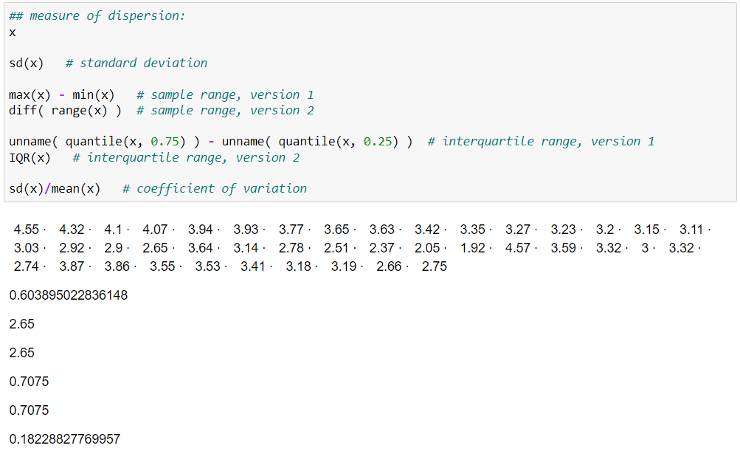
R Code

Slide 15
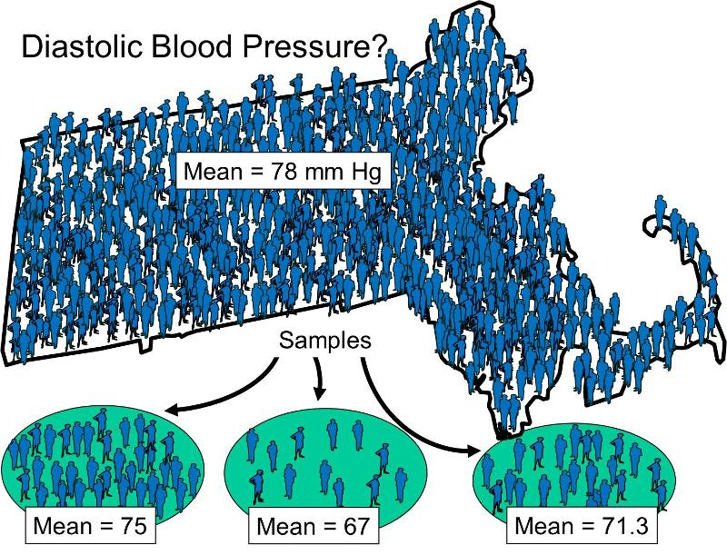
Summary Statistic
For the census of a population, the summary statistic is no longer a random variable.
For sample data, before sampling, the summary statistic is a random variable generated by the sample and has clear probability distribution characteristics.
For a specific sample (i.e., the sampling is done), the summary statistic is a specific number, which can be regarded as realizations of the corresponding random variables.

Slide 16
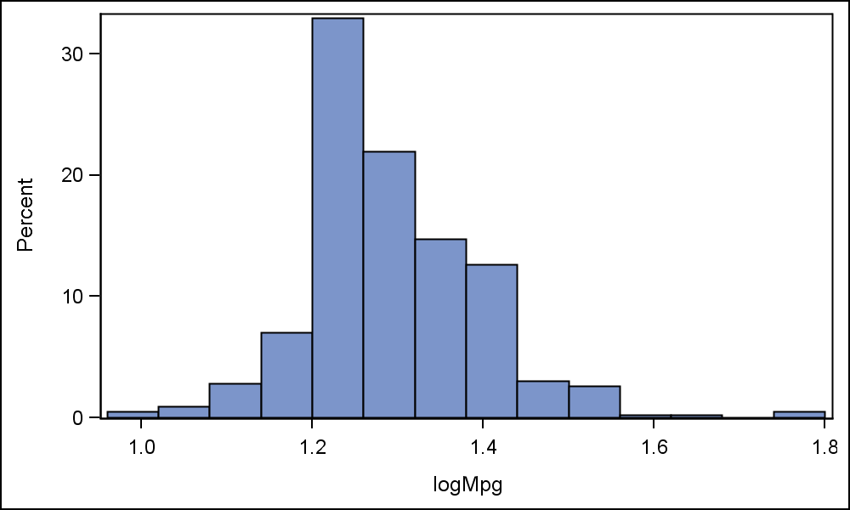
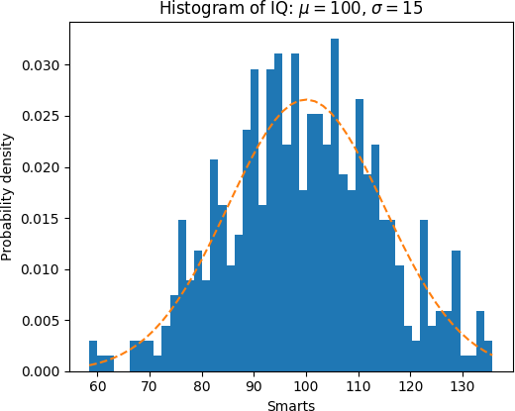
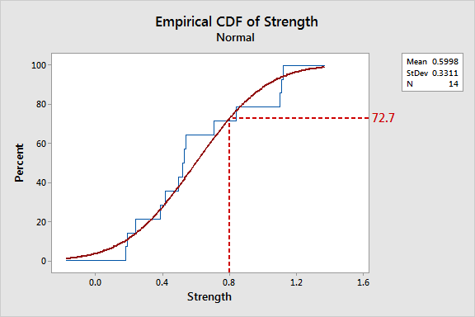
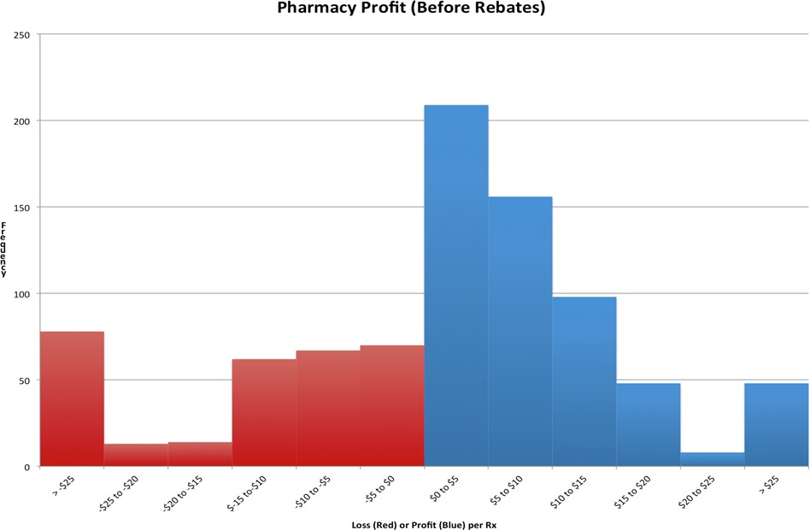
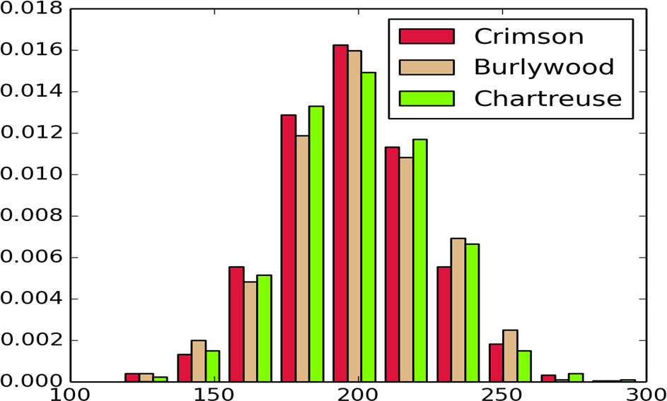
Distribution Characteristics of Continuous Variables

Slide 17
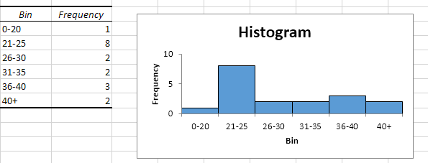
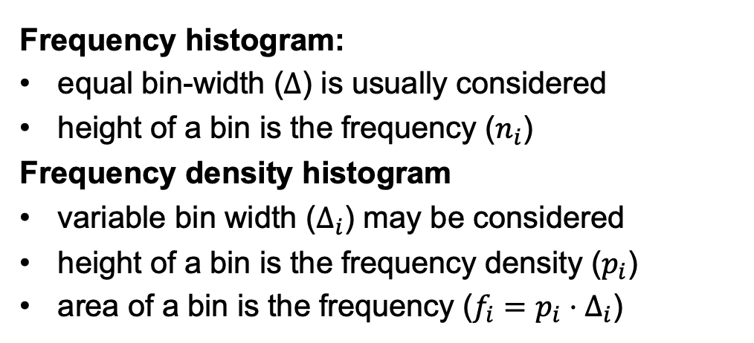
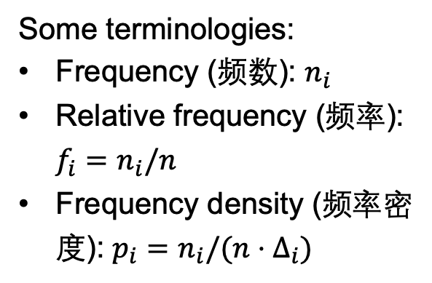
Histogram
Frequency histogram:
equal bin-width ($Δ$) is usually considered
height of a bin is the frequency ($n_{i}$)
Frequency density histogram
variable bin width ($Δ_{i}$) may be considered
height of a bin is the frequency density ($p_{i}$)
area of a bin is the frequency ($f_{i}=p_{i}⋅Δ_{i}$)
Some terminologies:
Frequency (频数): $n_{i}$
Relative frequency (频率): $f_{i}=n_{i}/n$
Frequency density (频率密度): $p_{i}=n_{i}/(n⋅Δ_{i})$
Notes:
In statistics: frequency = 频数，relative frequency = 频率
In physics: frequency = 频率…

Slide 18

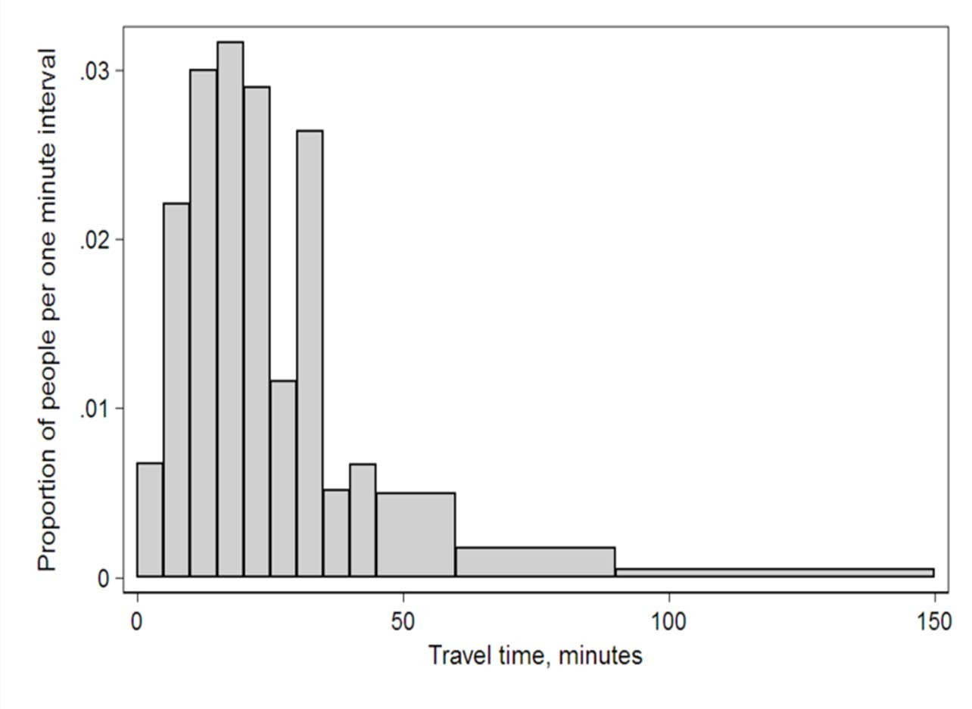
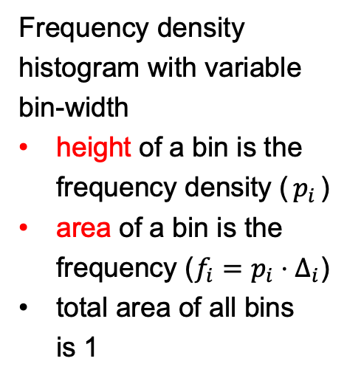
Interval | Width | Quantity (Q) | Q/total/width
0 | 5 | 4180 | 0.0067
5 | 5 | 13687 | 0.0220
10 | 5 | 18618 | 0.0300
15 | 5 | 19634 | 0.0316
20 | 5 | 17981 | 0.0289
25 | 5 | 7190 | 0.0115
30 | 5 | 16369 | 0.0263
35 | 5 | 3212 | 0.0051
40 | 5 | 4122 | 0.0066
45 | 15 | 9200 | 0.0049
60 | 30 | 6461 | ^{0.0017}
90 | 60 | 3435 | 0.0004
Frequency density histogram with variable bin-width
height of a bin is the frequency density ($p_{i}$)
area of a bin is the frequency ($f_{i}=p_{i}⋅Δ_{i}$)
total area of all bins is 1
Histogram of travel time, US 2000 census. Area under the curve equals the total number of cases. This diagram uses Q/total/width/ from the table.
Notes:
Here, height is not frequency.

Slide 19
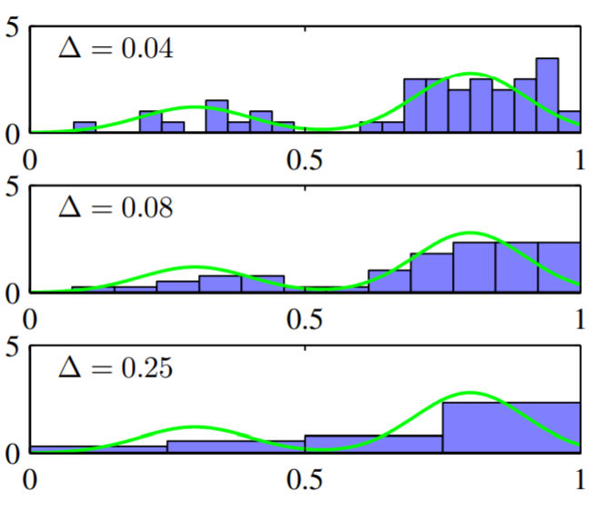
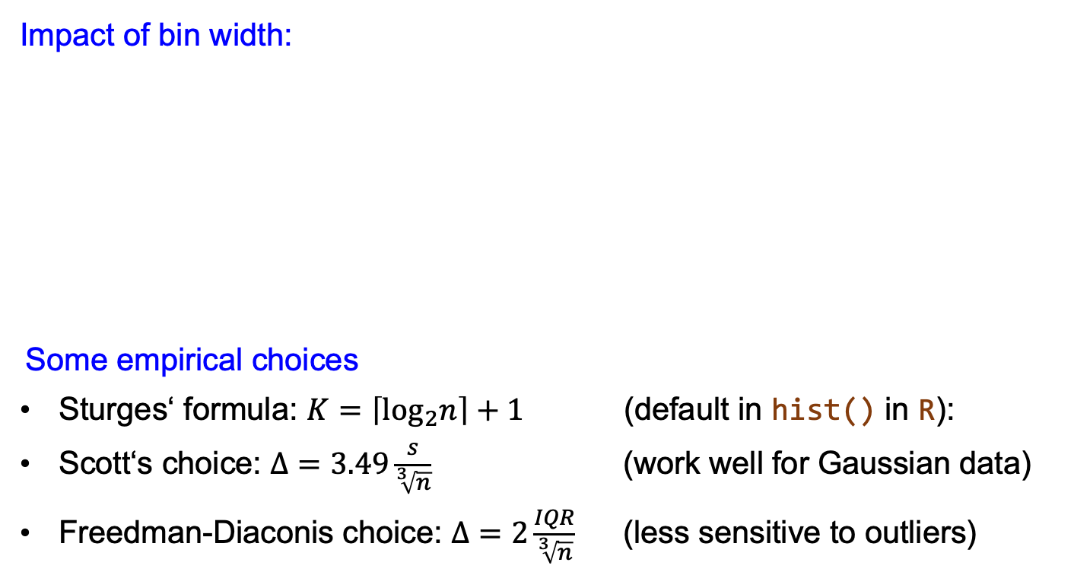
Histogram
Impact of bin width:
Some empirical choices
Sturges‘ formula: $K=\left\lceil \log_{2}n\right\rceil +1$ (default in hist() in R):
Scott‘s choice: $Δ=3.49\frac{s}{\sqrt[3]{n}}$ (work well for Gaussian data)
Freedman-Diaconis choice: $Δ=2\frac{IQR}{\sqrt[3]{n}}$ (less sensitive to outliers)

Slide 20
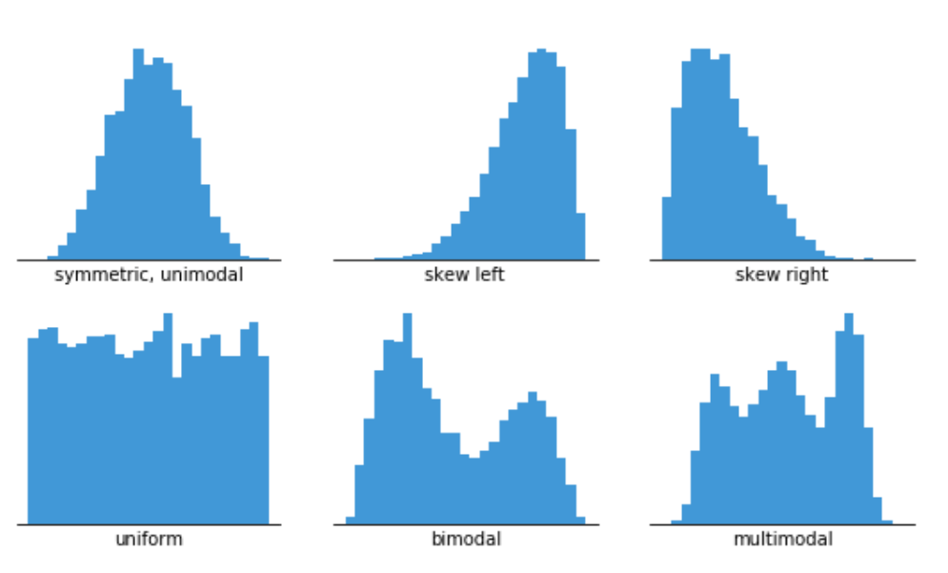
左偏
右偏
Commonly seen histograms

Slide 21
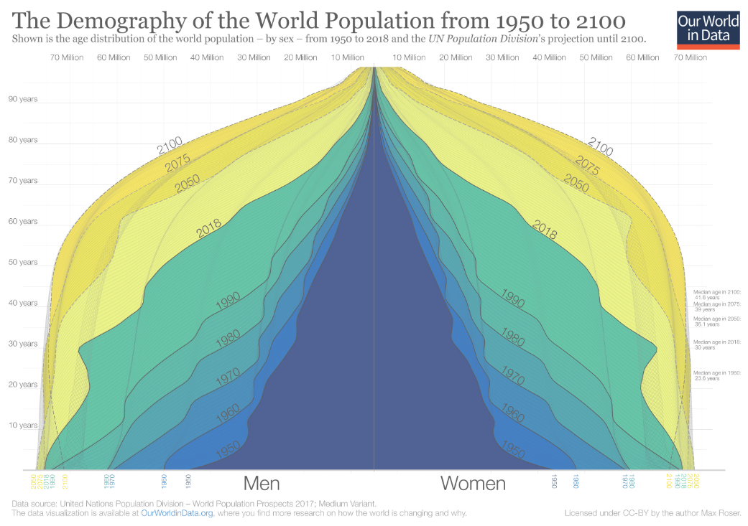

Slide 22
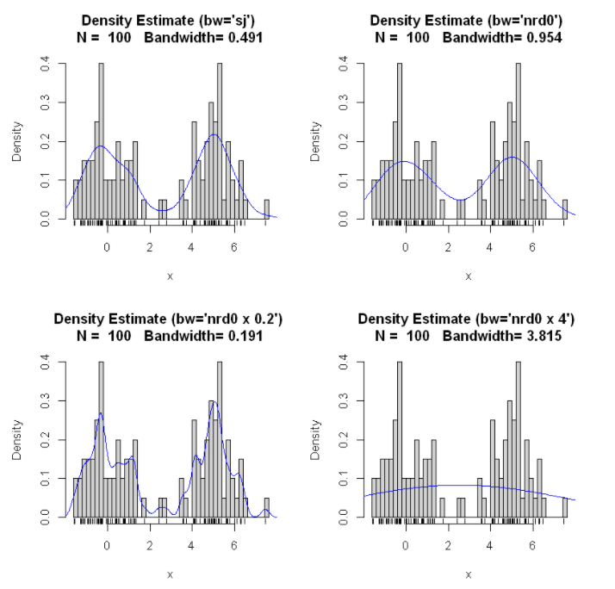
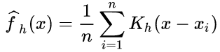
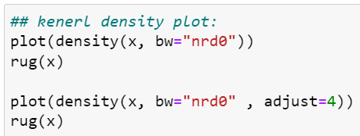
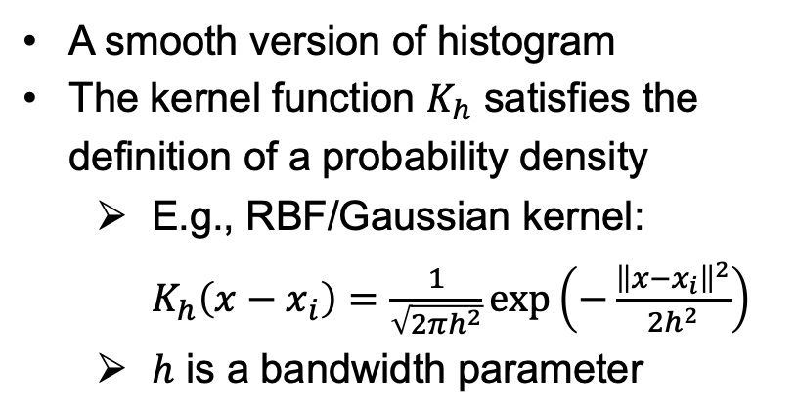
Kernel Density Plot
A smooth version of histogram
The kernel function $K_{h}$ satisfies the definition of a probability density
E.g., RBF/Gaussian kernel: $K_{h}\left(x−x_{i}\right)=\frac{1}{\sqrt{2πh^{2}}}exp\left(−\frac{{\left\|x−x_{i}\right\|}^{2}}{2h^{2}}\right)$
$h$ is a bandwidth parameter
Notes:
Histogram: a data points either lies in an interval or not
Kernel density plot: a data point give a small probability weight in the vicinity of the region

Slide 23
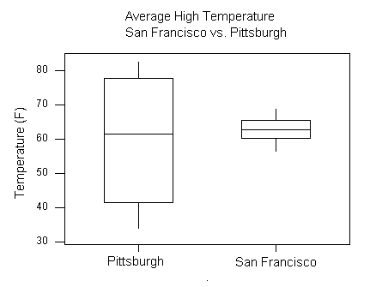
Box Plot
Graphically display the location and dispersion of the data, and possibly the outliers
The symmetry and skewness and of the data can be roughly observed
Can be used to compare multiple samples

Slide 24
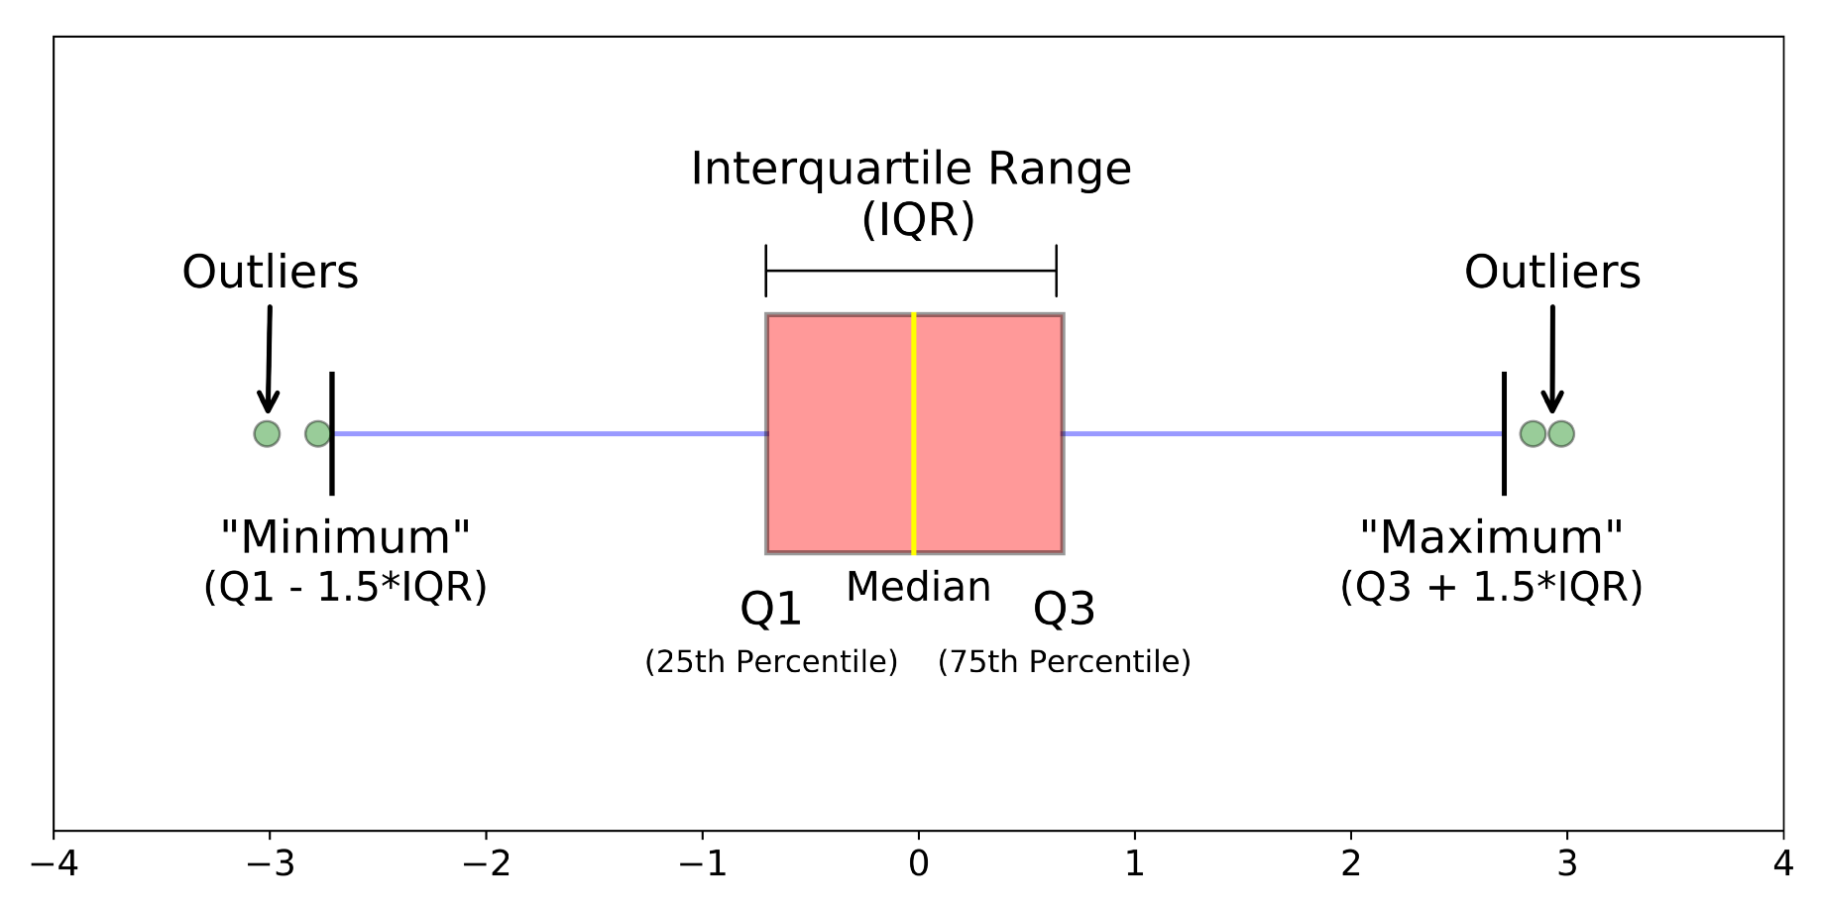
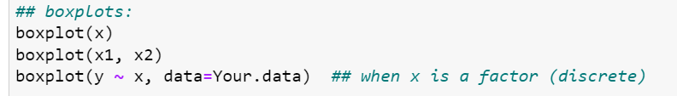
Box Plot
Horizontal lines are drawn at the median and at the upper and lower quartiles and are joined by vertical lines to produce the box.
A vertical line is drawn up from the upper quartile to the most extreme data point that is within a distance of 1.5 (IQR) of the upper quartile. A similarly defined vertical line is drawn down from the lower quartile. Short horizontal lines are added to mark the ends of these vertical lines.
Each data point beyond the ends of the vertical lines is marked with an asterisk or dot (* or ·).
Can be placed horizontally or vertically

Slide 25
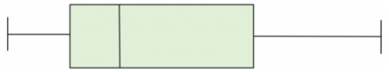



单选题
1分
Which empirical distribution below is the most likely one to yield the following box plot?
A
B
C
提交

Slide 26

Box Plot and Skewness

Slide 27

Example: Boxplots of daily maximum concentrations of sulfur dioxide.。Clambers et al (1983) concluded:
“The boxplots show many properties of the data rather strikingly. There is a general reduction in sulphur dioxide concentration through time due to the gradual conversion to low sulphur fuels in the region. The decline is most dramatic for the highest quantiles. Also, there are higher concentrations during the winter months due to the use of heating oil. In addition, the boxplots show that the distributions are skewed toward high values and that the spread of the distributions is larger when the general level of concentration is higher.”
Notes:
J.A.Rice Example 10.6.1

Slide 28



Violin Plot
Y axis: kernel density estimation
(More details than box plot)

Slide 29




Empirical CDF
Definition:
Computed from order statistics:
Advantage
No binning
Easy to readout quantiles
Easy to compare distributions
Notes:
Background on the second figure:
A nutrition consulting company created an education program to increase the calcium intake in children ages 9 to 13. To measure the effectiveness of the program, an analyst performs an experiment in which 200 children are assigned randomly to either the control group (no education) or the education group.
The data points for both groups closely follow the fitted normal distribution lines. The percentile lines show that approximately 50% of the children in the control group have calcium intake values of at least 808, while 50% of the children in the education group have calcium intake of at least 1113.

Slide 30





Q-Q Plot (quantile-quantile plot)
Compare empirical distribution of a sample to a theoretical distribution
Compare empirical distributions of two samples
Reference line: $y=x$
Same shape but with different locations
Notes:
若两组数据容量不等，可对其中一组数据使用插值求出相应的分位数。

Slide 31

主观题
1分
What can you learn from the QQ plot of samples A and B?
作答
Notes:
B的低分比A低，高分比A高（更为“两极分化”）

Slide 32


Q-Q Plot (quantile-quantile plot)
Notes:
(d): Y集的“低分组”比X集的“低分组”更低，Y集的“高分组”比X集的“高分组”更高。

Slide 33




Scatter Plot
Initial inspection of association between variables

Slide 34

To Think about:
Fitting to the whole data
negative correlation
Fitting to each sub-group
positive correlation
Likely a Simpson's Paradox
Q: what if we don’t know the cluster information beforehand?

Slide 35



Traffic Flux and Density
Fundamental diagram of traffic flow
Different clusters correspond to different traffic states.
Two common traffic models
Notes:
In steady state: flow = density * speed

Slide 36


Scatter Plot
Example 10.7.2, MSDA3, J. A. Rice

Slide 37



Scatter Plot v.s. Q-Q Plot
plot(x, y) v.s. qqplot(x, y)

Slide 38

Scatter Plot v.s. Q-Q Plot
qqplot(x, y)
Compares quantiles or two samples, based on their empirical distributions
Unlike scatter plot, no need for the two samples x and y to have one-to-one correspondence.
They can even have different sizes.

Slide 39
Types of Data

Slide 40
Categorical Data (分类数据 )
R: is.factor(), factor(), as.factor()
diabetes <- c("Type1", "Type2", "Type1", "Type1")
diabetes <- factor(diabetes)
status <- c("Poor", "Improved", "Excellent", "Poor")
status <- factor(status, ordered=TRUE, levels=c("Poor", "Improved", "Excellent"))
sex <- c(1, 2, 1, 1)
sex <- factor(sex, levels=c(1, 2), labels=c("Male", "Female"))

Slide 41



Bar Chart (柱形图)
Height represents frequency or relative frequency
Or use axis break to indicate the change of scale

Slide 42



Make a Guess

Slide 43

Pie Chart (饼图)
The sector arc length of a class is proportional to its frequency
Recommend not to use 3D graphs to display column charts and pie charts.

Slide 44



Example: Arthritis (关节炎数据)
Notes:
Notice which attributes are factors.
Factors of interest: treatment and improved

Slide 45





Example: Arthritis
R: table(), barplot(), pie()
Notes:
Factors to consider: treatment and improved.

